Slide 1


PLEDGE TO PROGRESS Sustainability Hackathon
Sponsored By
Your Team Name : #00FF00
Your team bio :
Ms Jayapadmini Kanchan
Mr Ganaraj K
Ms Shwetha S Shetty
Ms Madhura Hegde
Date : 06-04-2022

Slide 2
Problem Statement?
Why did you decide to solve this Problem statement?
With so much electricity consumed each day, shifting the electrical load would be very challenging
Reducing electric consumption will not be a simple task when you have to persuade a large percentage of the population
Consequently, since the collation is generated manually using sensors, chances to encounter some erroneousness readings of the prescribed value are practically possible

Slide 3
User Segment & Pain Points
Which user /advertiser segment would be early adopter of your product & why?
Educational Institutes- Laboratory (usage of PC, Electrical Devices), Cafeteria/Canteen, Hostel
Residential Area- Usage of AC(Regions like Coastal area, North India) Refrigerator, Cooler, Fan

Slide 4
Pre-Requisite
To build a framework that intents to reduce the impact of carbon footprint on the physical and mental health of people through prediction of optimal air quality using Machine Learning
What are the alternatives/competitive products for the problem you are solving?
data for the study through IOT device

Slide 5
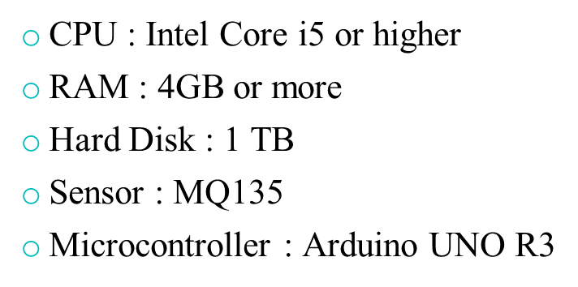
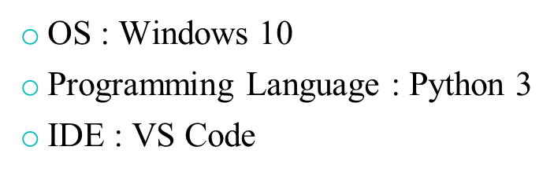
Tools or resources
Azure tools or resources which are likely to be used by you for the prototype, if your idea gets selected

Slide 6
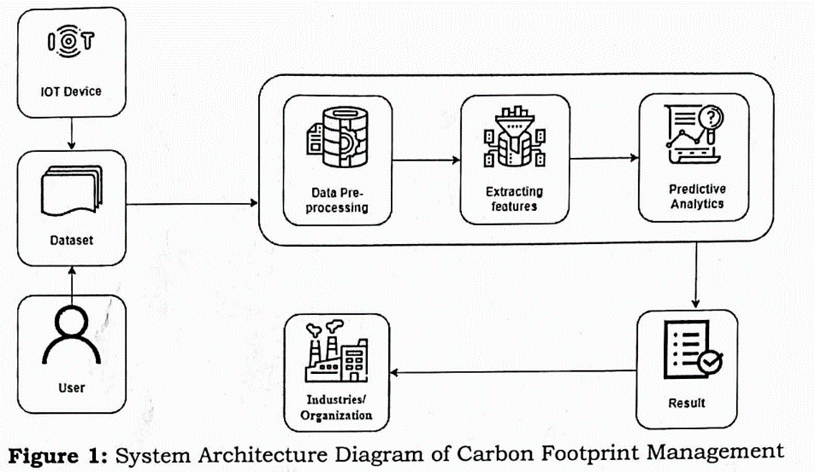
Any Supporting Functional Documents
Present your solution, talk about methodology, architecture & scalability

Slide 7
Key Differentiators & Adoption Plan
How is your solution better than alternatives and how do you plan to build adoption?
To collect the data for study through IoT Devices
To Considerably monitor the emission of green house gases and achieve the balanced Environment
To predict the impact of carbon footprint on the generation side of the system
Develop visualization to illustrate the forecasts of carbon emission

Slide 8
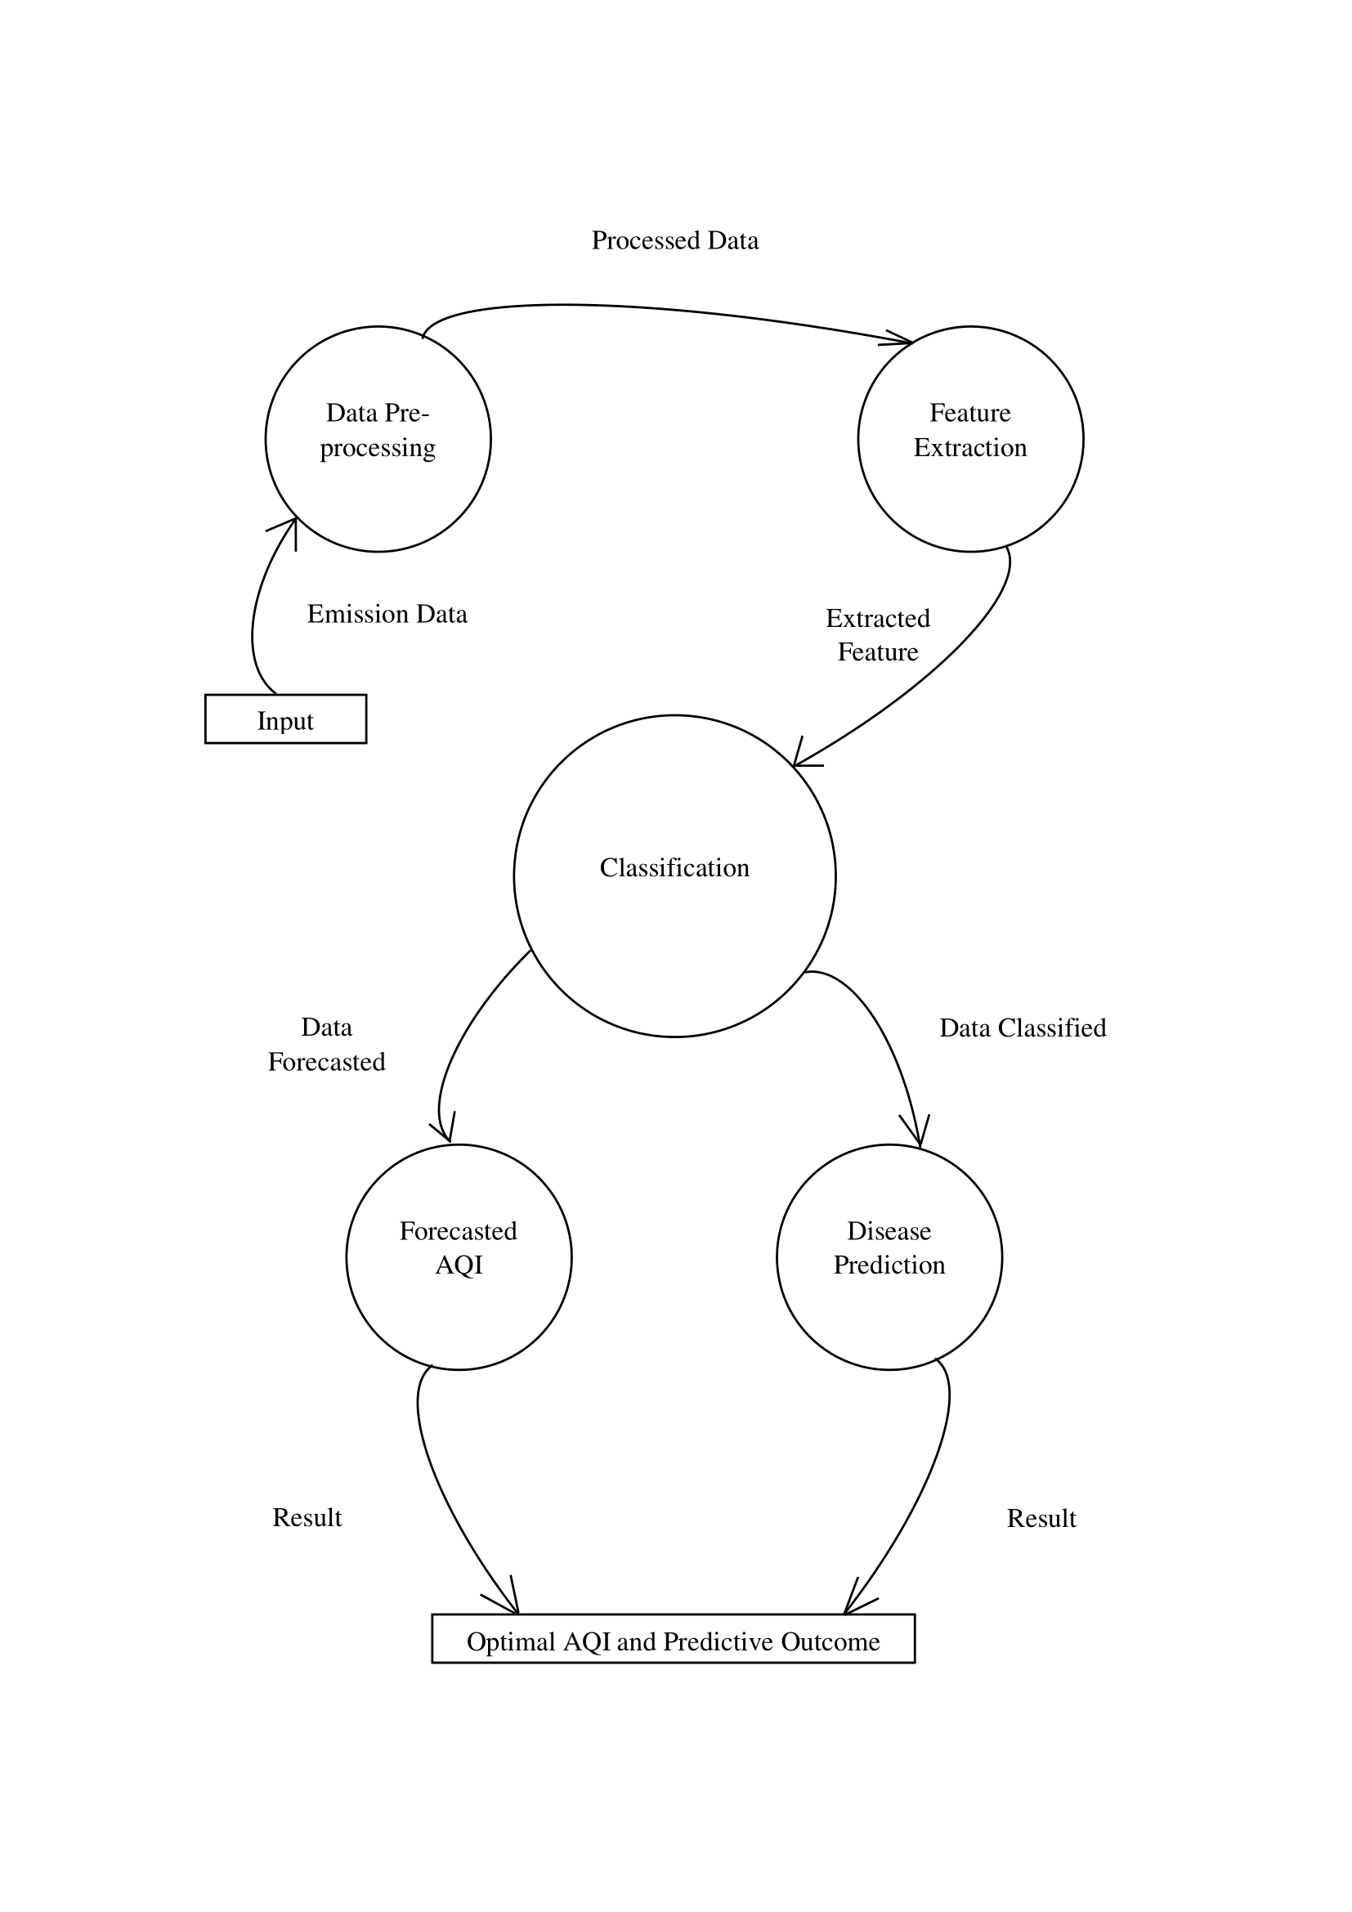
GitHub Repository Link & supporting diagrams, screenshots, if any
How far it can go?
carbon-footprint/idea at main · Jayapadmini/carbon-footprint (github.com)

Slide 9
Thank You
Team member names
Ms Jayapadmini Kanchan
Mr Ganaraj K
Ms Shwetha S Shetty
Mrs Madhura Hegde

